Slide 1

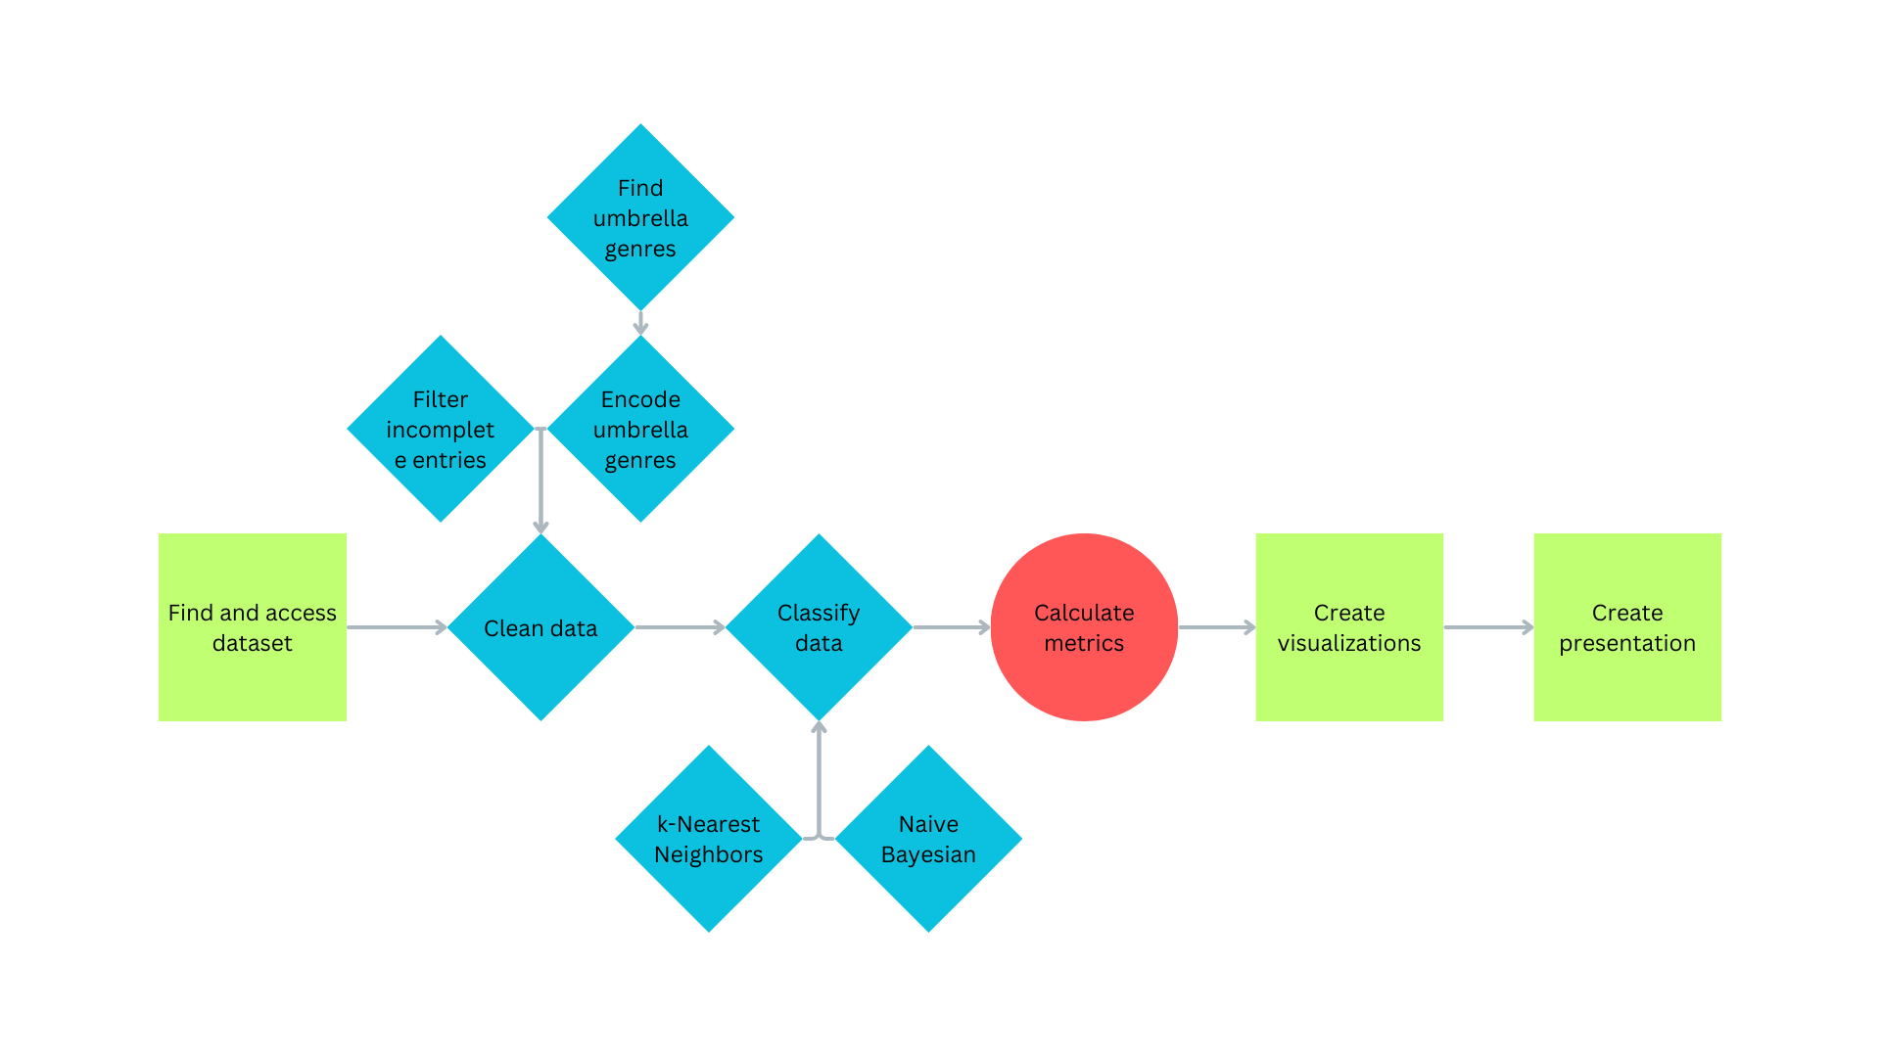
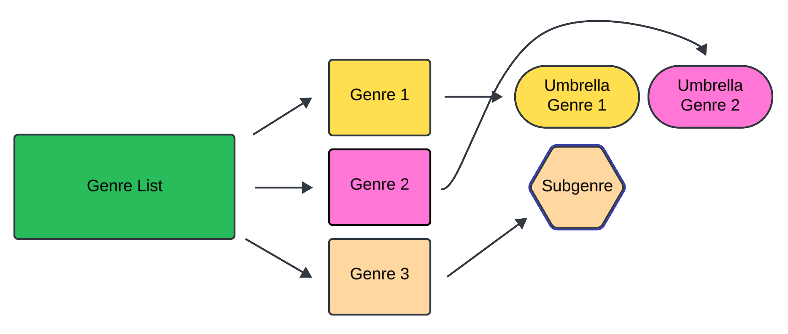
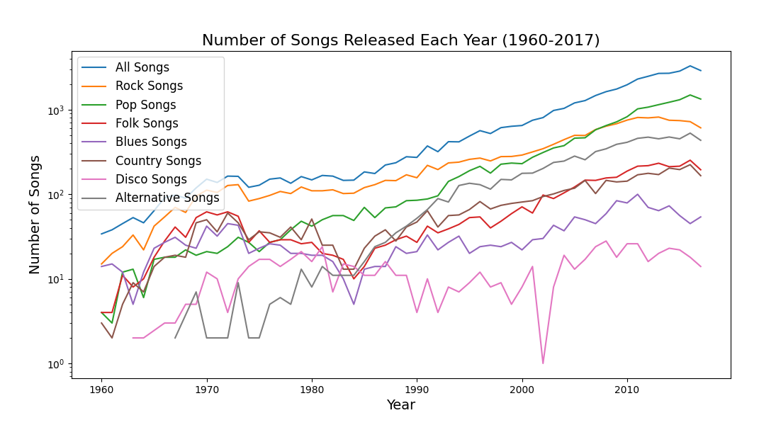
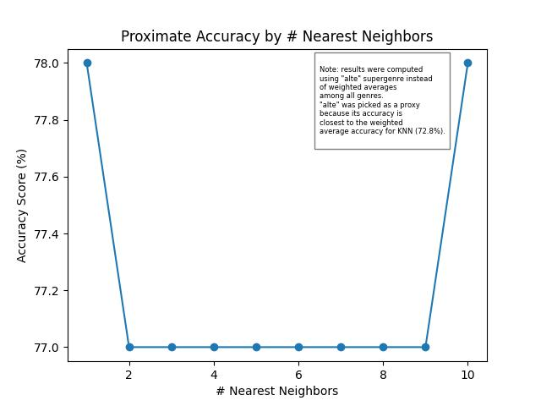
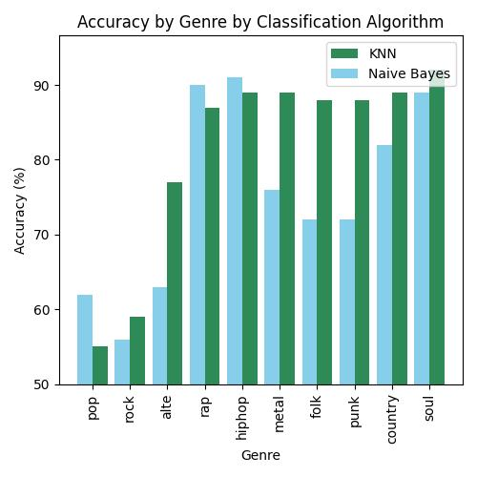
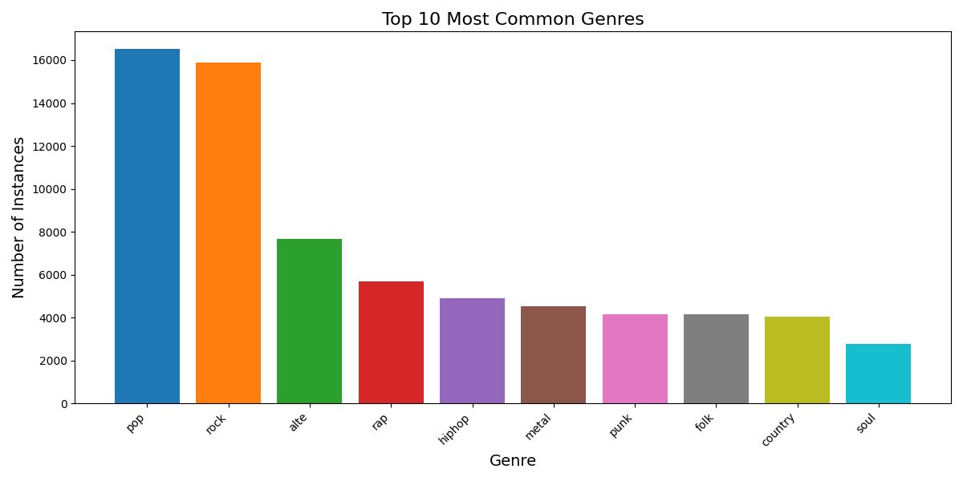
Lyric Lovers: Predicting Song Genre by Lyrics
Greyson Henry, Computer Science ‘26
Hayden Johnson, Economics ‘25
John O’Neil, History ‘25
Julia Hogg, Computer Science and English, ‘25
INTRODUCTION
METHODOLOGY
ERROR ANALYSIS
Our group sought to predict the genre of songs given their lyrics.
We all love music and wanted to explore a dataset centered around it. Something we found interesting was the different genre listings, so we decided to work with that in our project.
We hypothesize that a song’s genre can be predicted by its lyrics with an accuracy of >50%.
Workflow
Nearly half of the raw dataset lacked data for either lyrics or genre, limiting our training possibilities.
The dataset is quite sparse on a per-supergenre basis, which led to a very large number of true negatives to account for. This could possibly balloon accuracy.
Umbrella creation
DISCUSSION
DATA
Based on our results, umbrella genres are indeed predictable by lyrics with an accuracy of >50%.
Accuracy fluctuates wildly by genre, with rap and hip-hop predictions being particularly accurate.
Precision and recall scores remain subpar, likely due to the sparsity of our data (at least, on a by-genre basis).
The number of nearest neighbors used in the KNN classification doesn’t seem to substantially affect accuracy scores.
The dataset contains 481,000 English songs released from 1950 to 2017.
The two attributes of interest are the lyrics and the list of genres.
The lyrics come from Genius and the genres are sourced from Spotify.
RESULTS
 | Accuracy | Precision | Recall | F1-score
Nearest Neighbor | 72.8% | 37.1% | 28.2% | 15.4%
Naive Bayes | 69.1% | 41.4% | 59.7% | 23.4%
Random Class | 50.0% | 24.6% | 50.0% | 30.7%
Majority Class | 40.00% | 40.00% | 100% | 56.9%
The number of songs for each genre increased at a similar rate each year.
Accuracy | Soul (KNN)
Recall | Hip-Hop (Bayes)
Precision | Rap (Bayes)
F1 | Hip-Hop (Bayes)
Accuracy | Pop (KNN)
Precision | Punk (KNN)
Recall | Punk (KNN)
F1 | Punk (KNN)
Highest
SOURCES
Lowest
Song data from user brunokreiner on Hugging Face: https://huggingface.co/datasets/brunokreiner/genius-lyrics
This project was done in Python using the following libraries and modules:
pandas, NumPy, Matplotlib, tqdm, nltk, gc, pickle
We classified the 10 most popular umbrella genres pictured above. Pop and rock were the most common umbrella genres.
Special thanks to Dr. Sultan for his guidance.
Notes:
First, we dropped all entries missing lyrics or genres.
Then, we filtered our 300+ initial genres into 40 “umbrella” supergenres
(e.g., “country rap” has umbrellas of “country” and “rap”, while “British punk” has umbrella of “punk”)
Finally, we one-hot encoded every “umbrella” genre for every song in the data.

